Slide 1
CSS3 Transitions
CSS3 transitions allows you to change property values smoothly (from one value to another), over a given duration.
Example: Mouse over the element below to see a CSS3 transition effect

Slide 2
How to Use CSS3 Transitions?
To create a transition effect, you must specify two things:
the CSS property you want to add an effect to
the duration of the effect
Note: If the duration part is not specified, the transition will have no effect, because the default value is 0.
Example

Slide 3
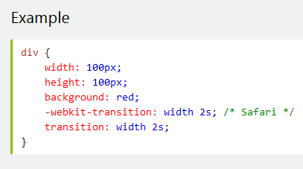
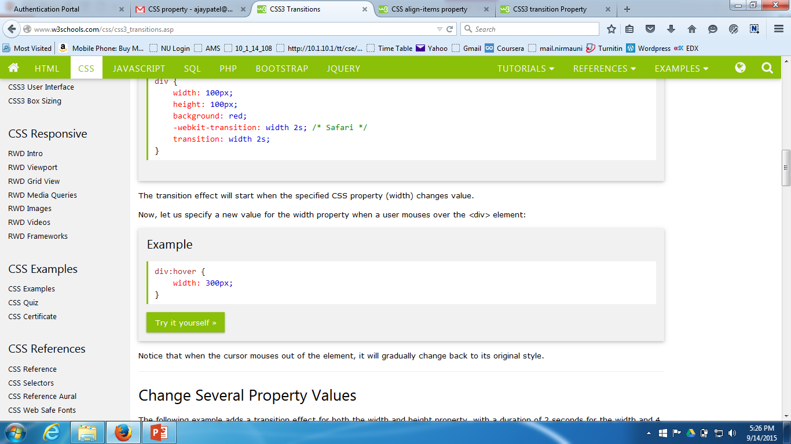
How to Use CSS3 Transitions?
The following example shows a 100px * 100px red <div> element. The <div> element has also specified a transition effect for the width property, with a duration of 2 seconds:

Slide 4
transition-property Property
The transition-property property specifies the name of the CSS property the transition effect is for (the transition effect will start when the specified CSS property changes).
Tip: A transition effect could typically occur when a user hover over an element.
Note: Always specify the transition-duration property, otherwise the duration is 0, and the transition will have no effect.
Example

Slide 5
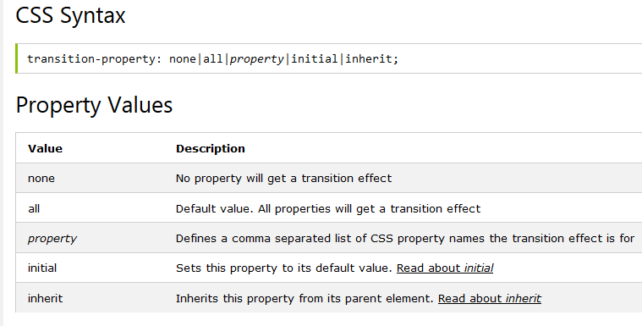
transition-property Property

Slide 6
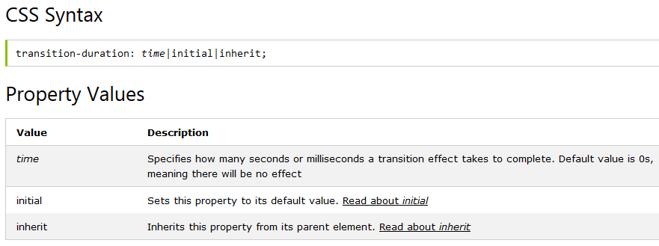
transition-duration Property
The transition-duration property specifies how many seconds (s) or milliseconds (ms) a transition effect takes to complete.
Example

Slide 7
transition-timing-function Property
The transition-timing-function property specifies the speed curve of the transition effect.
This property allows a transition effect to change speed over its duration.
Example

Slide 8
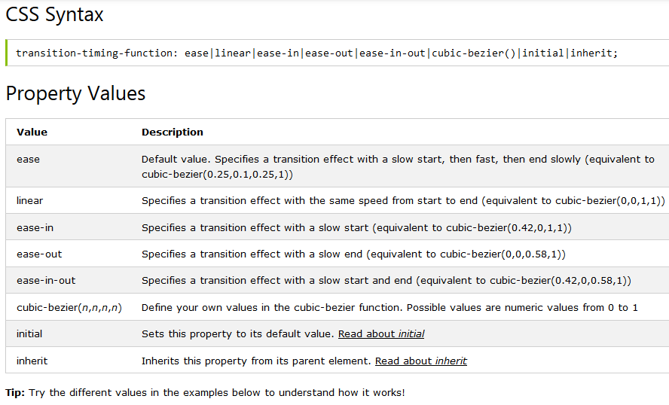
transition-timing-function Property

Slide 9
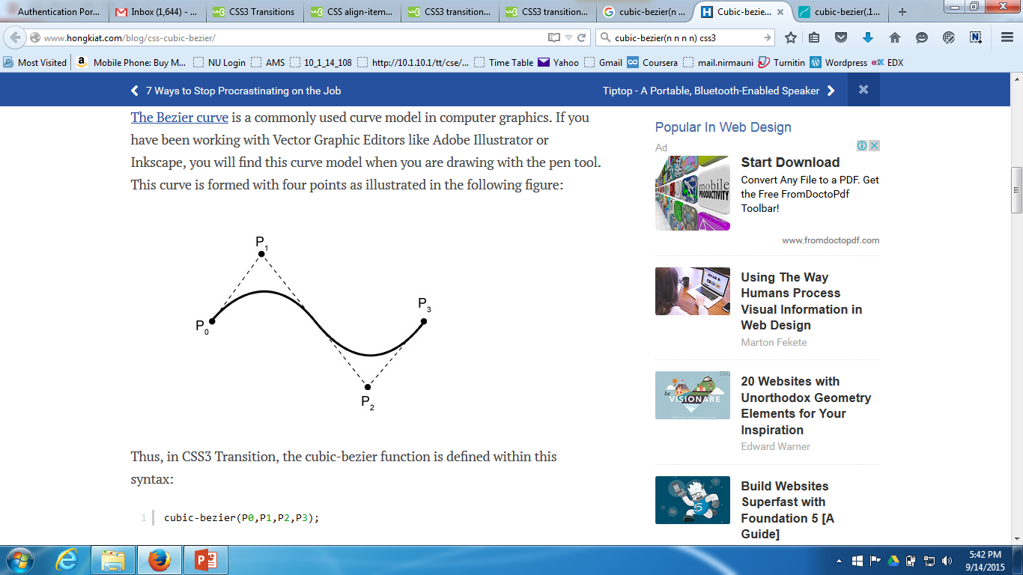
transition-timing-function Property
Bezier Curve
The Bezier curve is a commonly used curve model in computer graphics. If you have been working with Vector Graphic Editors like Adobe Illustrator or Inkscape, you will find this curve model when you are drawing with the pen tool. This curve is formed with four points as illustrated in the following figure:

Slide 10
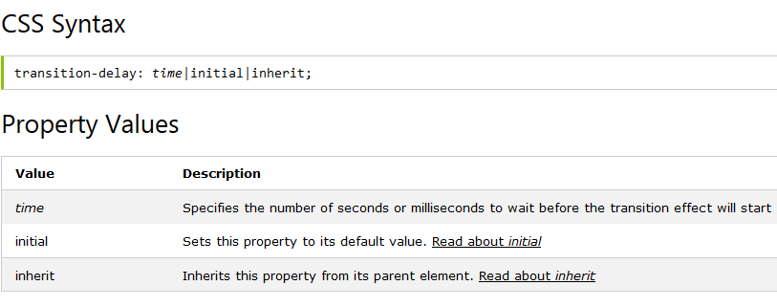
transition-delay Property
The transition-delay property specifies when the transition effect will start.
The transition-delay value is defined in seconds (s) or milliseconds (ms).
Example

Slide 11
transition Property
The transition property is a shorthand property for the four transition properties:
transition-property, transition-duration, transition-timing-function, and transition-delay.
Note: Always specify the transition-duration property, otherwise the duration is 0s, and the transition will have no effect.
Example

Slide 12
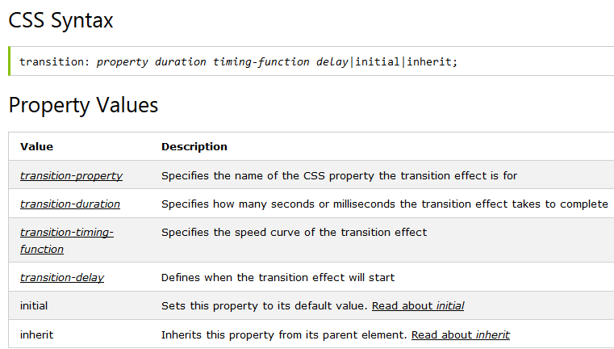
transition Property

Slide 13
CSS3 Animations
CSS3 animations allows animation of most HTML elements without using JavaScript or Flash!
What are CSS3 Animations?
An animation lets an element gradually change from one style to another.
You can change as many CSS properties you want, as many times you want.
To use CSS3 animation, you must first specify some keyframes for the animation.
Keyframes hold what styles the element will have at certain times.

Slide 14
CSS3 Animations
The @keyframes Rule
When you specify CSS styles inside the @keyframes rule, the animation will gradually change from the current style to the new style at certain times.
To get an animation to work, you must bind the animation to an element.
The following example binds the "example" animation to the <div> element. The animation will lasts for 4 seconds, and it will gradually change the background-color of the <div> element from "red" to "yellow":
Example

Slide 15
CSS3 Animations
The @keyframes Rule
Note: If the animation-duration property is not specified, the animation will have no effect, because the default value is 0.
In the example above we have specified when the style will change by using the keywords "from" and "to" (which represents 0% (start) and 100% (complete)).
It is also possible to use percent. By using percent, you can add as many style changes as you like.
The following example will change the background-color of the <div> element when the animation is 25% complete, 50% complete, and again when the animation is 100% complete:
Example

Slide 16
CSS3 Animations
The @keyframes Rule
Note: If the animation-duration property is not specified, the animation will have no effect, because the default value is 0.
In the example above we have specified when the style will change by using the keywords "from" and "to" (which represents 0% (start) and 100% (complete)).
It is also possible to use percent. By using percent, you can add as many style changes as you like.
The following example will change the background-color of the <div> element when the animation is 25% complete, 50% complete, and again when the animation is 100% complete:
Example

Slide 17
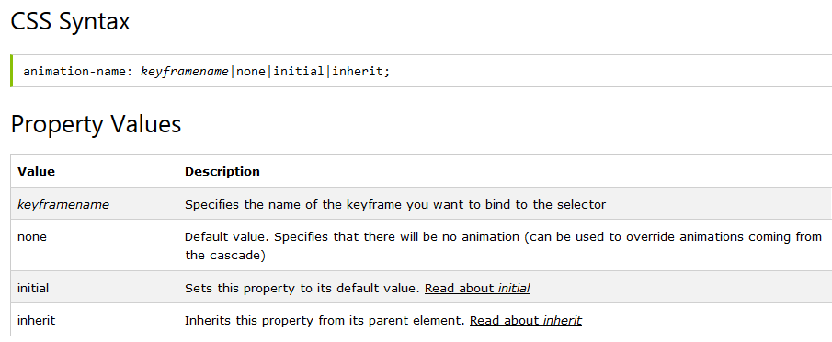
animation-name Property
The animation-name property specifies a name for the @keyframes animation.
Example

Slide 18
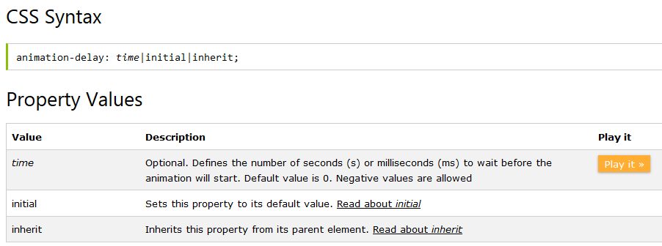
animation-delay Property
The animation-delay property specifies a delay for the start of an animation.
The animation-delay value is defined in seconds (s) or milliseconds (ms).
Example

Slide 19
animation-timing-function Property
The animation-timing-function specifies the speed curve of an animation.
The speed curve defines the TIME an animation uses to change from one set of CSS styles to another.
The speed curve is used to make the changes smoothly.
Example

Slide 20
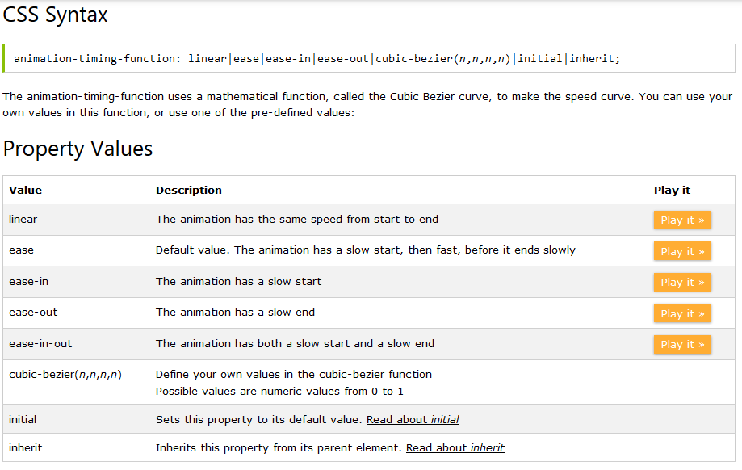
animation-timing-function Property

Slide 21
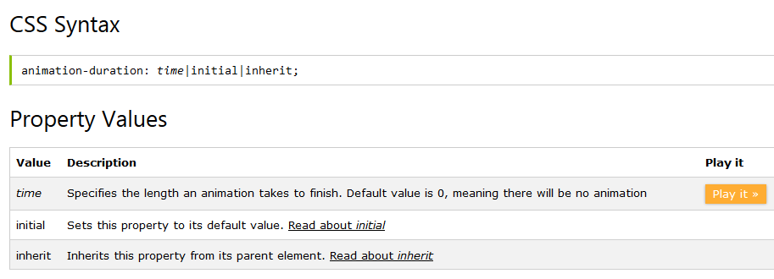
animation-duration Property
The animation-duration property defines how many seconds or milliseconds an animation takes to complete one cycle.
Example

Slide 22
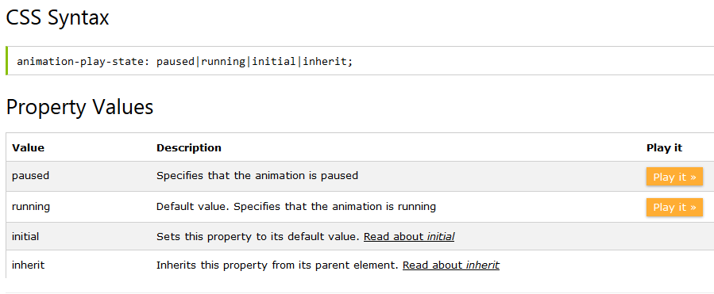
animation-play-state Property
The animation-play-state property specifies whether the animation is running or paused.
Note: Use this property in a JavaScript to pause an animation in the middle of a cycle.
Example

Slide 23
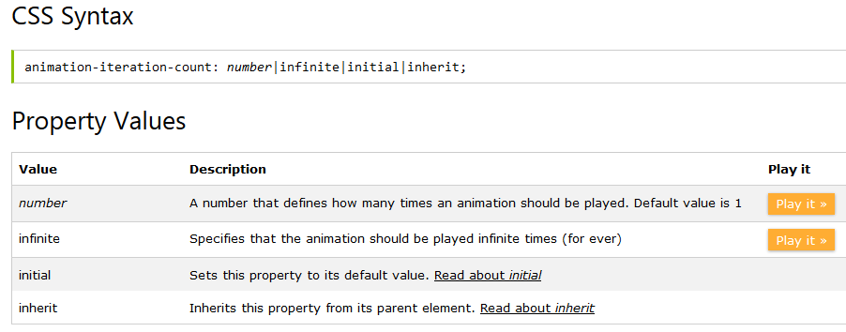
animation-iteration-count Property
The animation-iteration-count property specifies the number of times an animation should be played.
Example

Slide 24
animation-fill-mode Property
The animation-fill-mode property specifies a style for the element when the animation is not playing (when it is finished, or when it has a delay).
By default, CSS animations do not affect the element until the first keyframe is "played", and then stops once the last keyframe has completed. The animation-fill-mode property can override this behavior.
Example

Slide 25
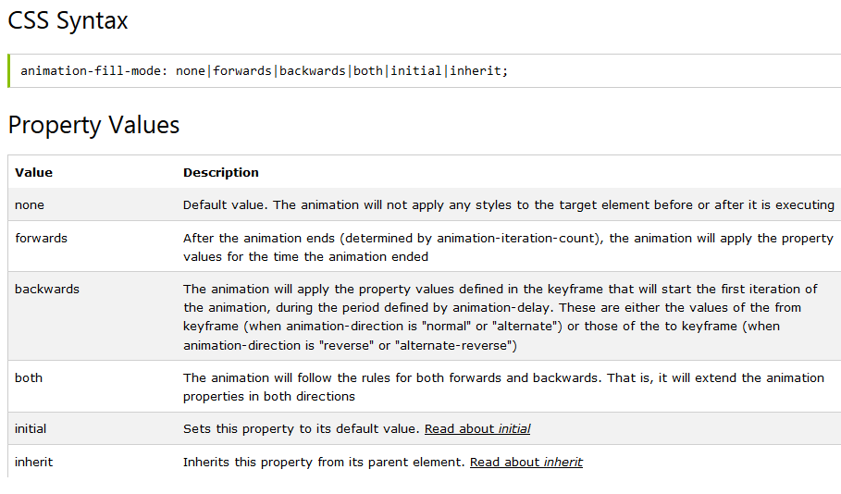
animation-fill-mode Property

Slide 26
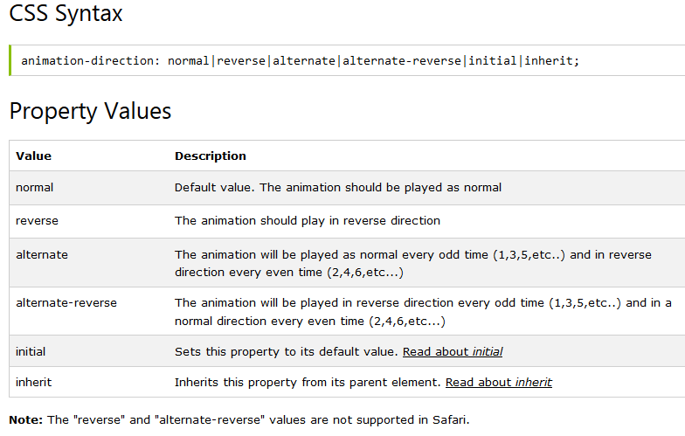
animation-direction Property
The animation-direction property defines whether an animation should play in reverse direction or in alternate cycles.
Example

Slide 27
animation Property
The animation-direction property defines whether an animation should play in reverse direction or in alternate cycles.
The animation property is a shorthand property for eight of the animation properties:
animation-name
animation-duration
animation-timing-function
animation-delay
animation-iteration-count
animation-direction
animation-fill-mode
animation-play-state
Note: Always specify the animation-duration property, otherwise the duration is 0, and will never be played.
Example

Slide 28
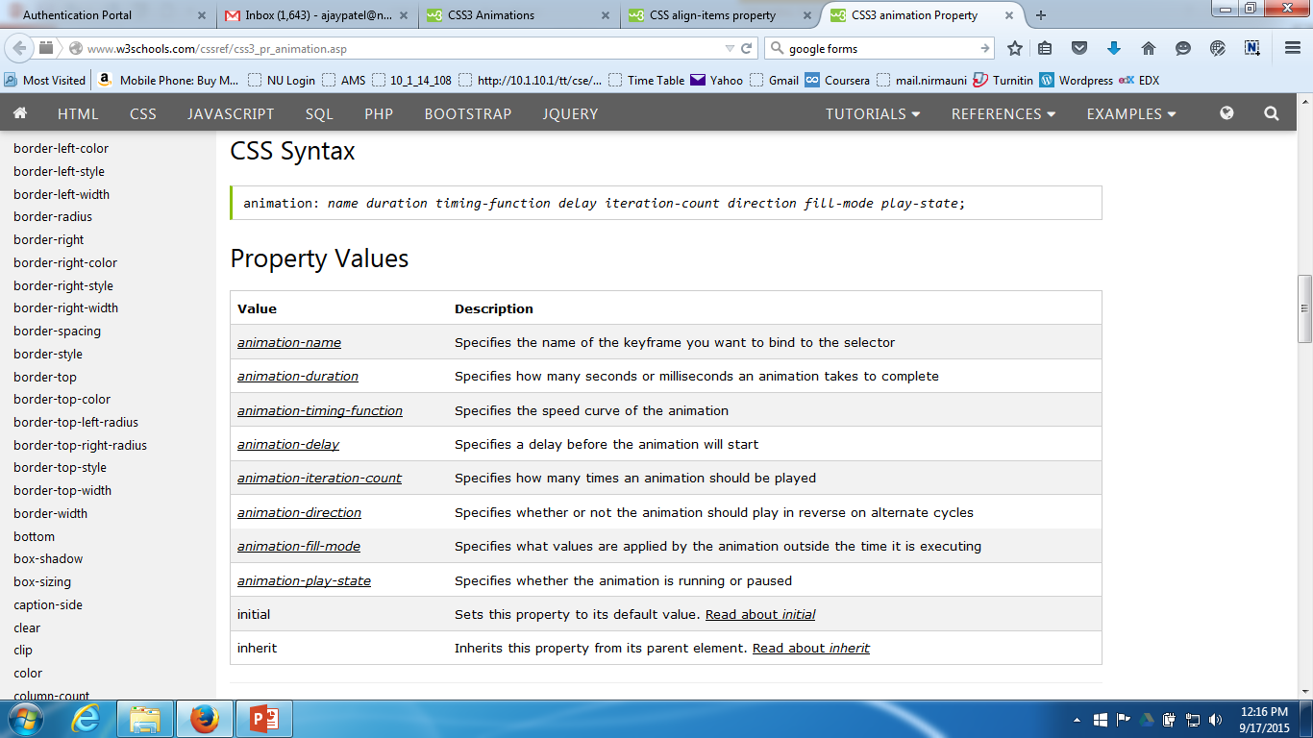
animation Property

Slide 29
References
http://www.w3schools.com/cssref/

Slide 30
Thank You…

